Slide 1

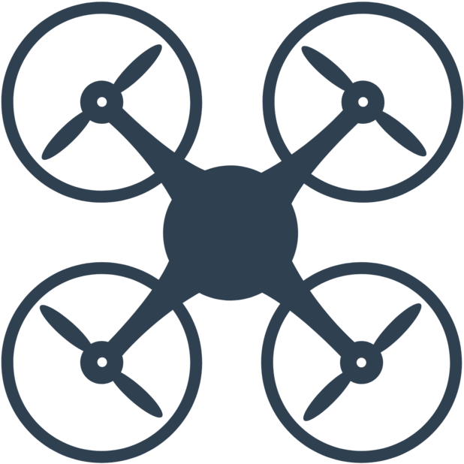
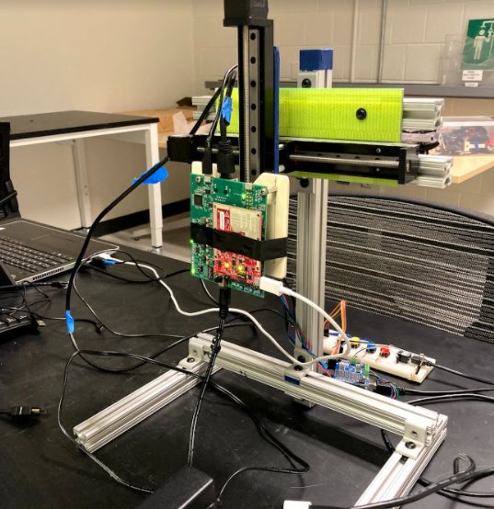
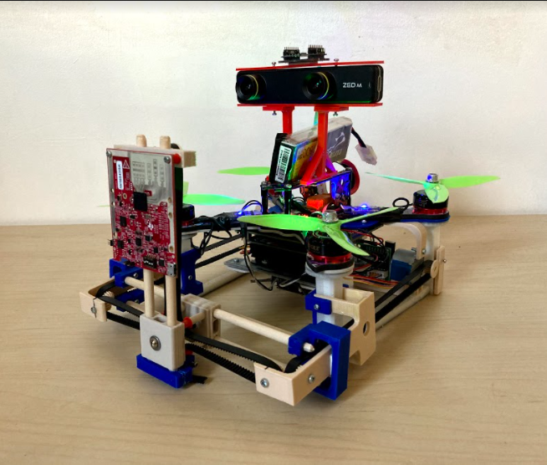
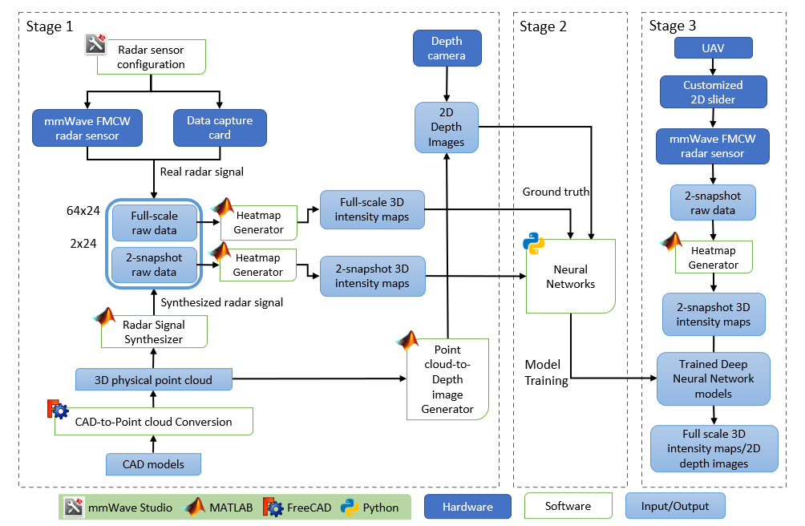
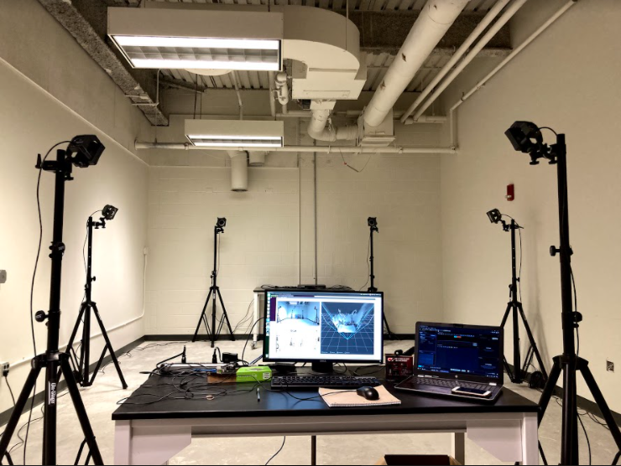
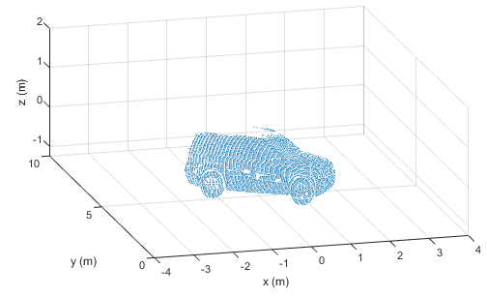

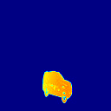
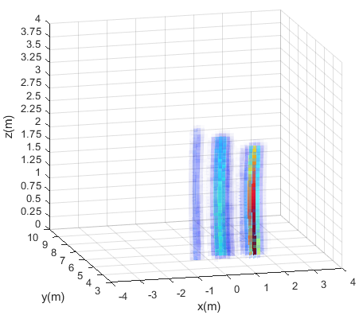
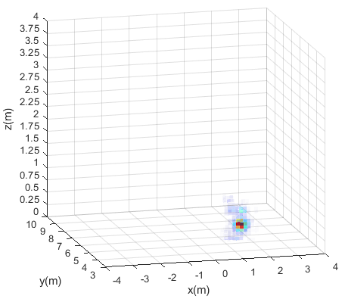
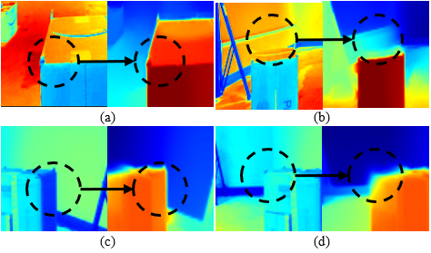
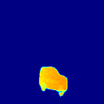
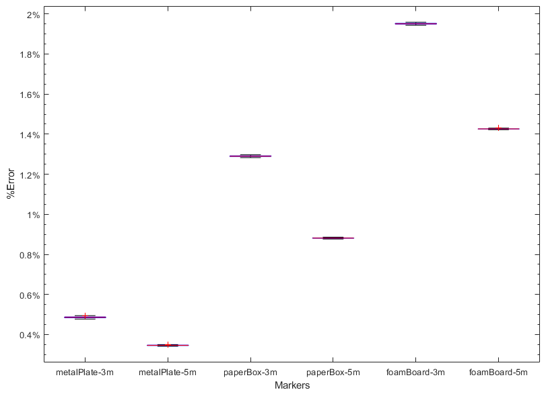
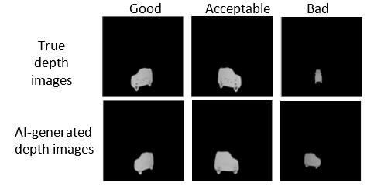
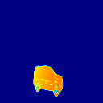
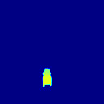
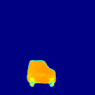
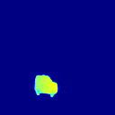
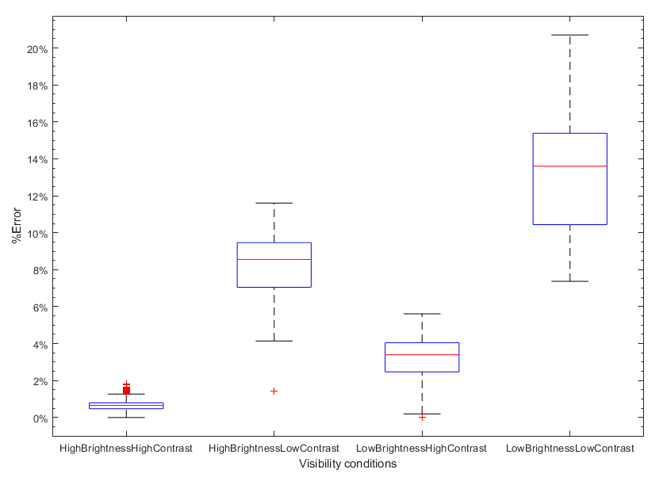
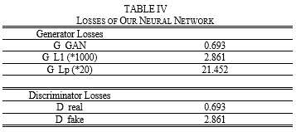
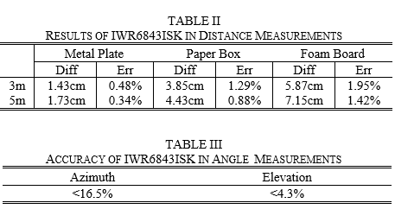
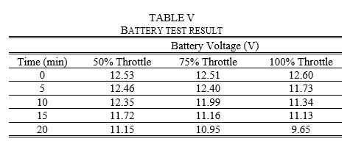
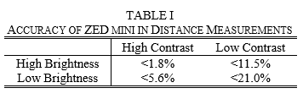
Fast mmWave RF 3D-Object Reconstruction
in Low-Visibility Environment via UAV Platform Zhuoming Huang, Alinson Sanquintin
Department of Engineering – University of Massachusetts Boston
Original surface in point cloud (single view)
Real 2D depth image
Reconstructed surface in point cloud
(single view)
Fig. 1. Test Environment for mmWave radar sensor and depth camera
3D radar intensity maps in Cartesian
(full scale)
Neural Network
AI-generated 2D depth image
Access to high-risk areas for explorations or rescues: unsafe in unknown environment (smoke, fog, low-visibility).
Non-intrusive, privacy-preserving monitoring for public health and safety: difficult to implement in large public areas.
Managements of large-scale facilities: need plenty of resource (time or labor) in traditional ways.
Autonomous driving
UAV with cameras and radar sensors can 3D-image and track objects with ease, low cost, high efficiency and high flexibility.
(2 snapshots)
Trained AI model
MOTIVATION
Fig. 2. Examples of pairs of brightness and depth images under four different visual conditions: (a) high brightness with high contrast, (b) high brightness with low contrast, (c) low brightness with high contrast, (d) low brightness with low contrast.
Fig. 5. Process of NN test
The system is mainly composed of four parts:
mmWave Radar sensor TI IWR6843ISK [3]
1x8 virtual antenna array available at each radar signal capture with MIMO configuration
64x24 (full-scale) or 2x24 (2-snapshot) virtual antenna array with 2D-sliding mechanism for SAR operations.
4GHz bandwidth allows a range resolution of 4cm
Small-sized and lightweight off-the-shelf product, suitable for small-sized UAV platform
Depth Camera ZED mini [4]
Captures 2D depth images as ground truth for AI model training
Lightweight off-the-shelf product, suitable for small-sized UAV platform
Neural Network
UAV-sensing: Producing 2D depth images from 2-snapshot 3D radar intensity maps
AI Model-training: Producing full-scale 3D intensity maps from 2-snapshot 3D intensity maps, and producing 2D depth images from full-scale 3D radar intensity maps
UAV Platform
Consisting of the Crazyflie2.1 with BigQuad, flow-v2, multi-ranger decks, and PCB deck connectors, Jetson Nano, customized 2D-sliding mechanism, IWR6843ISK radar sensor, ZED mini depth camera
DESIGN VALIDATION
Fig. 6. Examples of results from NN test
Fig. 4. Percentage error in measurements of distances to a metal plate, a paper box, and a foam board at 3m and 5m away. Results are measured by IWR6843ISK in compare to the OptiTrack.
Fig. 3. Overall percentage error of ZED mini in distance measurements under the four visibility conditions.
DESIGN DESCRIPTION
mmWave Radar
+
Depth Camera
+
Neural
Network
UAV Platform
+
mmWave Radar
3D-Object Reconstruction System featuring:
Functions of Deep Neural Network model training, fast generations of depth images from sparse raw mmWave radar data with UAV platform
Low cost, small size, light weight, high-flexibility, and high-efficiency RF imaging in low-visibility environment
Conclusions:
Budget for UAV sensing: under $1000
Reached deliverables
Future Plan:
Building Deep Neural Network models with multiple-view 3D intensity maps/2D depth images
Flight stabilization through better PID tuning and balancing
Larger loads with more powerful motors and bigger drone frame
3D-space mapping and reconstruction
Two-stage Operation
AI Model Training Stage
Relatively-high-resolution SAR operation large number of snapshots
AI model training
UAV Sensing Stage
Relatively-low-resolution SAR operation: two snapshots, fast
Transferring captured signal to fixed terminal for data processing
Producing 2D depth images from relatively-low-resolution radar intensity maps [1][2]
Reconstructing 3D-objects with multiple 2D depth images.
PROJECT DEFINITION
FINAL PRODUCT,
CONCLUSIONS & FUTURE PLAN
References
[1] J. Guan, S. Madani, S. Jog, and H Hassanieh.“High Resolution Millimeter Wave Imaging for Self- Driving Cars.”. 2020. IEEE CVPR (2020).
[2] S. Fang and S. Nirjon. “SuperRF: Enhanced 3D RF Representation Using Stationary Low-Cost mmWave Radar.” 2020. International Conference on Embedded Wireless Systems and Networks (EWSN), Vol. 2020. NIH Public Access, 120.
[3] Texas-Instruments, IWR6843ISK, 2021 [Online]. Available: https://www.ti.com/tool/IWR6843ISK
[4] STEREOLABS, ZED mini, 2021 [Online]. Available: https://www.stereolabs.com/zed-mini/
Acknowledgements – May 4th
This work was supported in part by the Depart­ment of Engineering, University of Massachusetts Boston, Technical Manager and Custumer Mentor Dr. Honggang Zhang, Dr. Tomas Materdey, Dr. Michael B. Rahaim, Ph.D. student Yue Sun, and Lucas E. Lomba.

Slide 2
Original surface in point cloud (single view)
Reconstructed surface in point cloud
(single view)
Real 2D depth image
3D radar intensity maps in Cartesian
(full scale)
Neural Network
AI-generated 2D depth image
(2 snapshots)
Trained AI model

